Slide 1
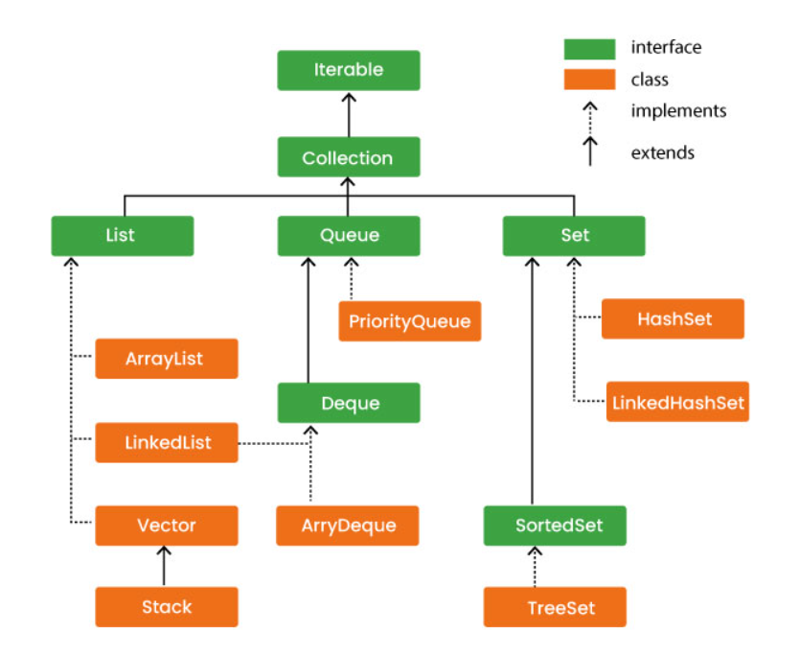
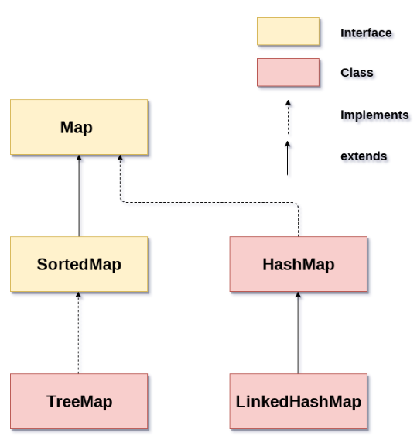
Collections

Slide 2
Iterable Interface
The Iterable interface in Java is a core interface in the Java Collections Framework. It belongs to the java.lang package and serves as the root interface for all collection classes, allowing them to be looped over using the enhanced for loop (for-each loop) or to obtain an Iterator object explicitly.
The Iterable interface declares a single method called iterator(), which returns an Iterator object. This Iterator object is used to iterate over the elements in the collection sequentially. The Iterator interface provides methods like hasNext() and next() for iterating through the elements.

Slide 3
Iterator
The Iterator interface in Java provides a way to iterate over elements in a collection sequentially. The Iterator interface defines several methods that enable you to iterate through a collection, check for the existence of elements, retrieve elements, and remove elements if supported by the collection.
hasNext()
next()
remove()
forEachRemaining()

Slide 4
Collection Interface
The Collection interface in Java is the root interface of the Java Collections Framework. It represents a group of objects known as elements. The Collection interface provides a set of methods for working with collections of objects, such as adding, removing, querying, and manipulating elements.
add()
addAll()
clear()
contains()
containsAll()
equals()
hashCode()
isEmpty()
iterator()
remove()
removeAll()
size()

Slide 5
Collections Class
The Collections class in Java is a utility class that provides static methods for working with collections.
It contains various methods for manipulating and performing operations on collections such as lists, sets, and maps.
Some of the key functionalities provided by the Collections class include sorting, searching, shuffling, reversing, filling, copying, finding the index of elements, maximum, minimum and more.

Slide 6
HashMap
Java HashMap class implements the Map interface which allows us to store key and value pair.
it is denoted as HashMap<K,V>, where K stands for key and V for value
Java HashMap maintains no order.
Java HashMap contains only unique keys.
Java HashMap may have one null key and multiple null values.

Slide 7
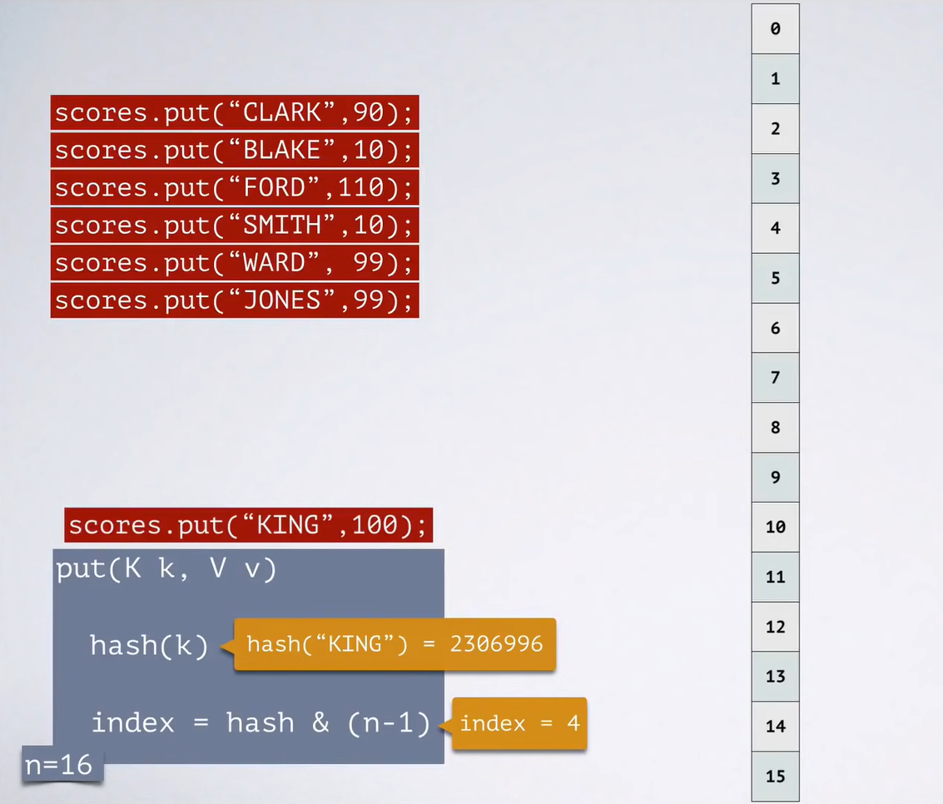
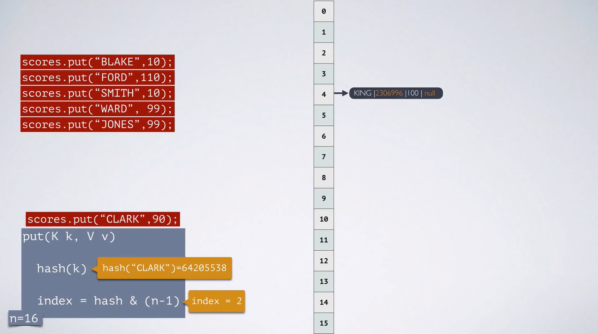

Slide 8
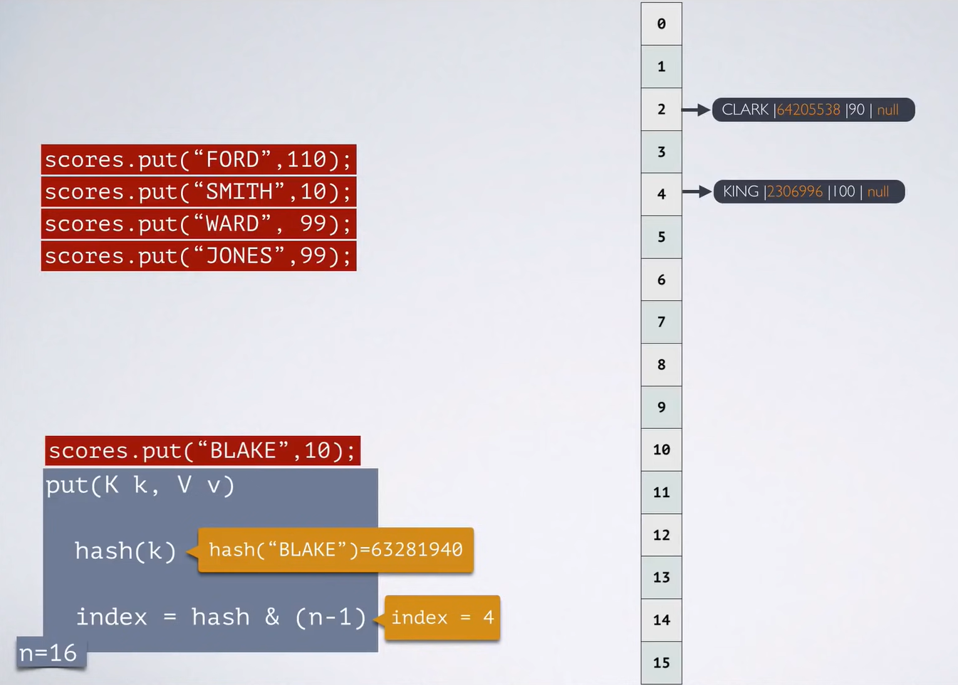
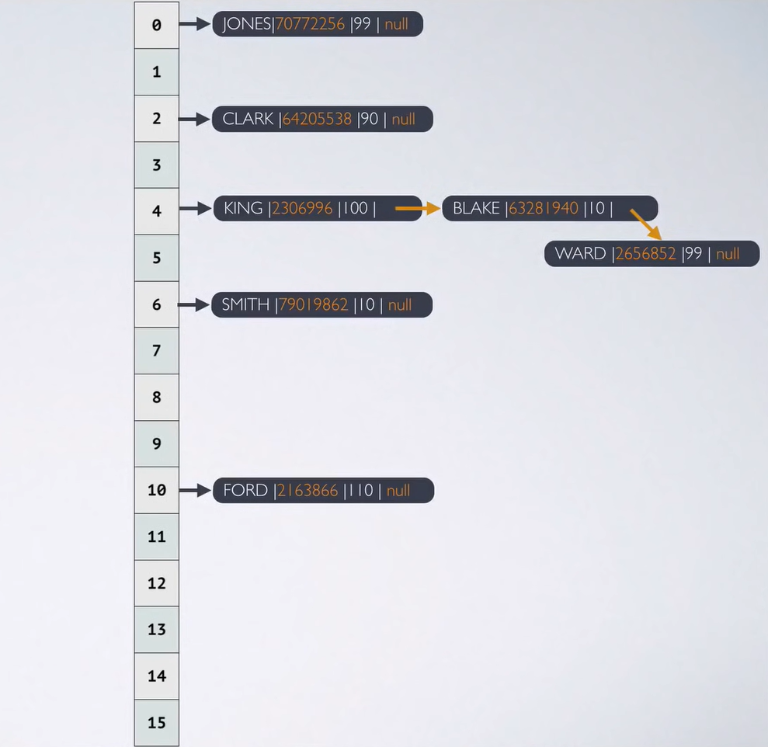

Slide 9
LinkedHashMap
Java LinkedHashMap class implements the Map interface which allows us to store key and value pair.
it is denoted as LinkedHashMap<K,V>, where K stands for key and V for value
Java LinkedHashMap maintains insertion order.
Java LinkedHashMap contains only unique keys.
Java LinkedHashMap may have one null key and multiple null values.

Slide 10
TreeMap
TreeMap provides an efficient means of storing key-value pairs in sorted order.
Java TreeMap contains only unique elements.
Java TreeMap cannot have a null key but can have multiple null values.
Java TreeMap maintains ascending order.

Slide 11
Identity HashMap
The IdentityHashMap class is similar to the HashMap class.
It uses reference equality rather than using the equals() method. It is used when the user needs the objects to be compared using the reference.
It uses the == operator.
We need to import java.util package to use IdentityHashMap class.

Slide 12
Vector
Vector is like the dynamic array.
we can store n-number of elements in it as there is no size limit.
Vector is synchronized.
It is recommended to use the Vector class in the thread-safe implementation only.
If you don't need to use the thread-safe implementation, you should use the ArrayList, the ArrayList will perform better in such case.

Slide 13
THANK YOU

